Slide 1


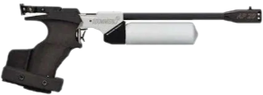

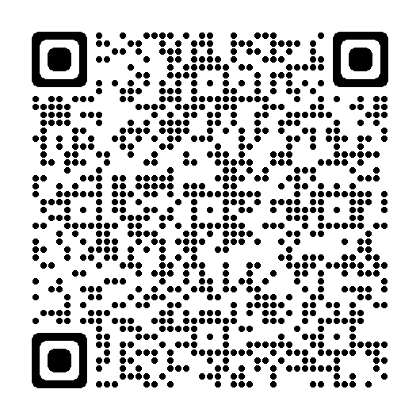
WTSC Celebrating 30 years
Worth Training for a TOP GUN
Competition Categories & Overall Prizes
Medals awarded for Monthly Winners
Non IPC Members - €150
IPC Over 15’s unassisted – Air Pistol
IPC Under 15’s unassisted – Air Pistol
Assisted – Trophy & Voucher for lessons x 5
Raffle: IPC members who take part in minimum 3 events
IPC Branch Team unassisted – Air Pistol for PC Branch
Pistol - 60 shot under TSI competition rules
Rifle - 60 shot under TSI competition rules
Assisted Rifle – 20 shot Individual Competition
Schools Individual Competition – 20 shot
IPC Team Competition: - 4 Member Team to be submitted to Contact Us – Wilkinstown Target Shooting Club (wilkinstowntsc.ie)
3 Best scores taken over the 4 competitions
(Select day & time that suits you)
20th – 22nd October
17th – 19th November
8th – 10th December
26th – 28th January
Enter here: https://www.itsplainsailing.com/org/tsi
T&C on itsplainsailing

Slide 2
T&C’s
The League (All Competitors) :
20 shot match in 15 minutes.
Enter as many times as you like.
Best score counts per competition.
Combined best 3 competition scores to qualify for the league.
Additional shooting details will be made available if required.
IPC – Irish Pony Club U15/Over 15’s Category
Must be a member of an Irish pony club branch.
Combined best 3 competition scores for the league.
Competitors to enter age category based on age on the 1st January 2024.
Minimum 3 competitions must be shot for the score to count in the league.
Minimum 30 competitors must complete the league for the pistol to be awarded.
Teams Category :
4 members per team – Email your selected team to info@wilkinstowntsc.ie before the 1st competition or 2nd if only taking part in 3 competitions.
Each competitor can only be part of one team.
Best 3 scores per competition.
Must be a member of a pony club branch.
The team does not need to shoot at the same time – Pick which time/day suits each individual.
Combined best 3 competition team scores for the league.
Minimum 3 competitors must shoot per competition for the team score to count.
Teams can be made up of anyone, boys/girls/mixed, from within their own pony club branch once they are within the age category on the 1st January 2024.
Winning team must have valid authorisation form to register the pistol against before it can be physically awarded.
Minimum 6 teams must complete the league for the pistol to be awarded.

